Slide 1
Data Manipulation & Management - Overview
Jeremy Bergmann - Omaha Data Science Academy

Slide 2
What are the course objectives?
Understand the need and purpose behind data manipulation, storage/retrieval, cleaning and management within Data Science projects.
Perform common queries, aggregations, and joins
Combine disparate data sets for analysis
Perform common data extraction, cleaning/transform and loading tasks (ETL)
Understand basic theory behind database design
Evaluate cloud storage platforms and NoSQL alternatives

Slide 3
How is this class structured?
Hour 1: Previous Class Review + Quiz, Lecture on Theory
Hour 2: Emphasis on application, the concrete
Hour 3: Hands-on Exercises & Class Project, Questions

Slide 4
Class 1 Objectives
Install Software
MySQL Server,MySQL Workbench + Examples
Sublime Text - Anaconda Python IDE
Github Desktop
Class Repository: https://github.com/jbergmann56/OSDA-DataManipulationAndManagement
Later in course: Dataiku, Google Cloud - BigQuery & Data Studio
Define data manipulation Define table
Define database How to create a table
Define SQL How to insert data into a table
Define ETL Define common data types

Slide 5
What is the need for data manipulation?
Creating new datasets & Combine disparate data sets
Perform common queries, aggregations, and joins
Adding, removing, or modifying data
Extracting and Storing Data
Creation/Extraction
Transformation data
Cleaning data
Retrieval
Notes:
Creation: creating tables and databases, the things
Storage: where data are stored
Cleaning: adding, removing, or modifying data
Retrieval: selecting only the data you want

Slide 6
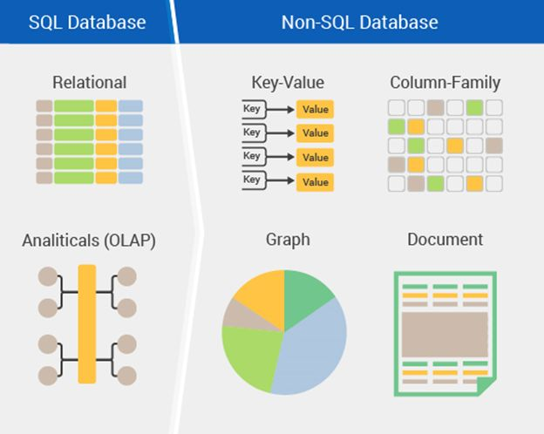
How can you manage large amounts of data?
Storage - Relational or Non-Relational DBs
Relational Database Lingo:
Table - the only data structure in SQL, where data is directly stored
Database - large container filled with tables
Field/Record - column/row
Schema - how a table or database is organized or designed
Notes:
Why Not?
SQL came first by about 40 years, so more businesses use it. Python is harder to learn. SQL is designed to only handle data, so it is fast. Faster than native Python lists or dictionaries. Pandas dataframes are appropriate depending on the context. It’s easier to show and share your work if you document your cleaning process in Jupyter Lab.

Slide 7
What is SQL?
Structured Query Language - Structured Query Language (SQL) is a standard computer language for relational database management and data manipulation
Dialects include MySQL, SQLite, MS SQL Server, Oracle, PostgreSQL, IBM DB2
Query: statement that asks for information from the database
Runs locally, on a server, or in the cloud
Simple and fast - Only one data structure, Optimized

Slide 8
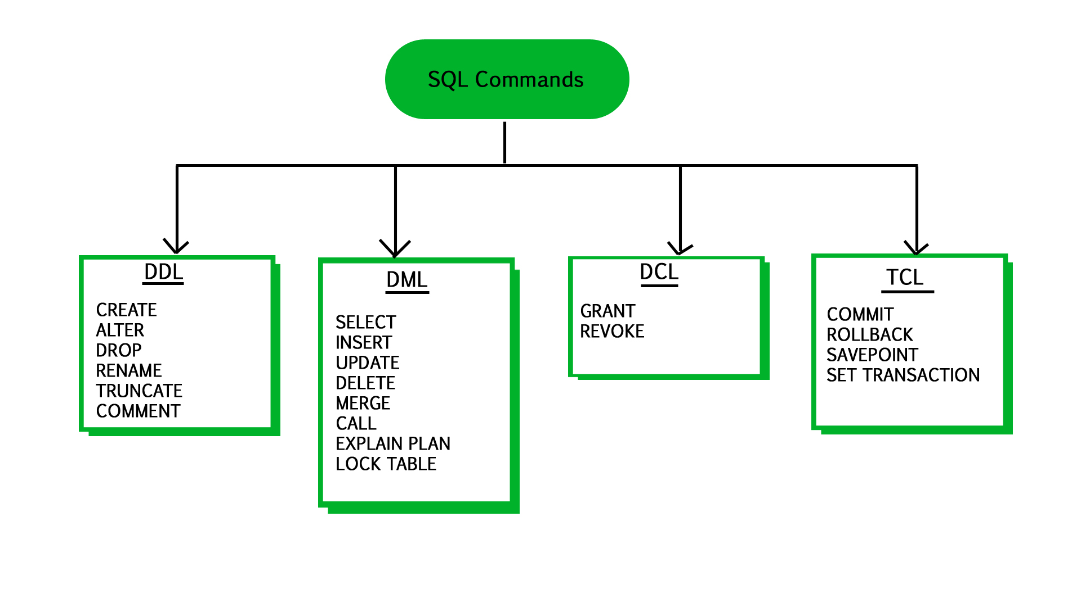
SQL Components
User Access
modifying data structures
Version Control
manipulating data
Notes:
Data Definition Language (DDL) Statements for defining and modifying data structures Ex: DROP, ALTER, RENAME, TRUNCATE
Data Manipulation Language (DML) Statements for manipulating data in tables Ex: SELECT, INSERT, UPDATE, DELETE
Data Control Language (DCL) Statements for managing users’ rights Ex: GRANT, REVOKE
Transaction Control Language (TCL) Statements for saving changes; a limited kind of version control Ex: COMMIT, ROLLBACK

Slide 9
What is a database?
A database is a collection of information that is organized so that it can be easily accessed, managed and updated.
Advantages
Security
Data integrity
Customization
Recovery
Persistence
Data Sharing
Disadvantages
Learning curve
Abstract
Maintenance & Dev costs
Notes:
Security: databases have additional security measures
Data integrity: data changes require intent
Customization: you can organize it best on your needs
Recovery: you don’t lose the data if there’s a catastrophic error
Learning curve: you have to learn how to manipulate it
Abstract: a less visual representation and demands more from the user

Slide 10
What is a table?
Tables: Any display of information in tabular form, with rows and/or columns named
Columns (fields): Set of named values that define the data within in a table.
Rows (records): A single, implicitly structured data item in a table.
CREATE TABLE students (
fname varchar(255),
lname varchar(255),
age int
);
INSERT INTO students (fname, lname, age)
VALUES ('Nathan', 'Booth', 31),
('Fatima', 'Asad', 22),
('Zoe', 'Stoklos', 42);

Slide 11
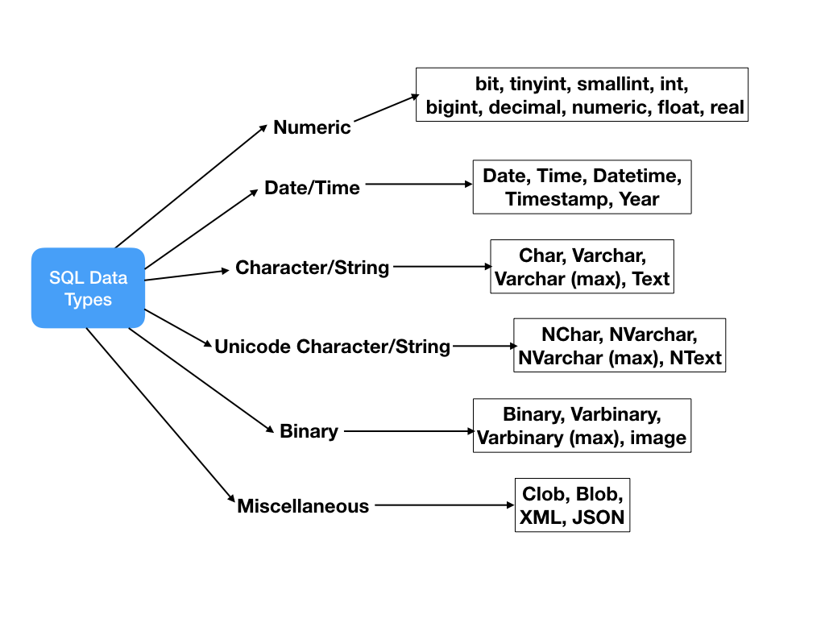
What data types can you use?
Tutorial: https://www.tutorialspoint.com/mysql/mysql-data-types.htm

Slide 12
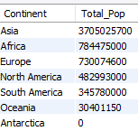
Data Manipulation - Example
What is the total world population by continent?
SQL Query
SELECT /*what columns to get*/
Continent, sum(Population) as Total_Pop
FROM world.country /*what schema/table to read*/
GROUP BY continent /*combine rows by column value*/
ORDER BY continent DESC /*Sort rows in result*/
LIMIT 50 /*limit number of rows to “bring back*/
Notes:
Format for readability
FROM: what table to read
SELECT: what columns to get
AS: rename the column
GROUP BY: combine rows by column value
ORDER BY: sort in ascending or descending order
LIMIT: constrain the number of rows displayed

Slide 13
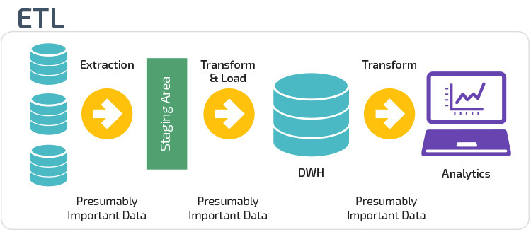
What is ETL?
Data often comes from multiple sources and incompatible formats
Common tools: IBM InfoSphere, DataStage, Oracle Warehouse Builder, SQL Server Integration Services, Talend Studio for Data Integration

Slide 14
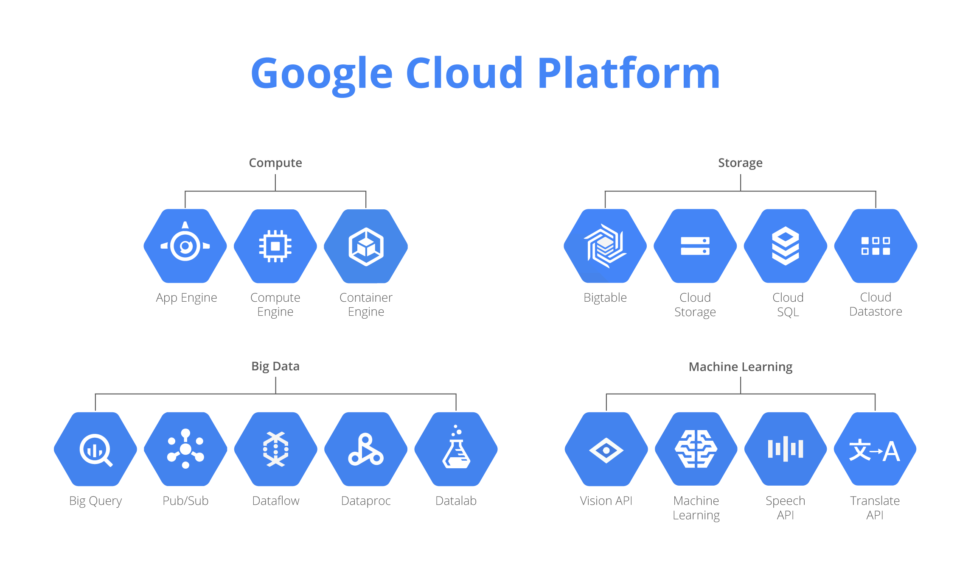
What is Cloud Storage?
Cloud storage is a cloud computing model in which data is stored on remote servers accessed from the internet [1]
Cloud File Storage: Dropbox, Box, Google Drive, Office 365, etc.
Cloud Platforms providing hosted services: Amazon AWS, Google GCP, Microsoft Azure, etc.
Notes:
[1] Techopedia - https://www.techopedia.com/definition/26535/cloud-storage

Slide 15
Where can you learn more SQL?
Interactive Tutorials
W3schools
SQLZoo
Mode Analytics
SoloLearn
SQL Tutorial
SQLBolt
Database Performance (advanced)
Static Tutorials and Books
TutorialsPoint
Head First SQL (Chpt.1 free)
SQL: A Beginner's Guide
SQL in a Nutshell
SQL for Smarties (advanced)
Video
Basics in an hour
Khan Academy
Game
Schemaverse
Sandbox
SQLfiddle
MySQL Sandbox
Courses
Codecademy (self-paced, free and paid)
Stanford’s Database Mini-Courses
SQL Course 2
Documentation and Help
MySQL Reference Manual
Databases 101
MS SQL Server
Stack Overflow
Reddit

Slide 16
Class Project - Problem Understanding & Goal
Problem Statement
The senior leadership team at “NameCo, Inc” would like to create a new smash-hit video game, intended for the hand-held console market. After much brainstorming, the CEO declares that “People love drama, so let’s create a new “Barbie Adventure Game”!”
After the meeting, there was an uneasy feeling about investing in a “Barbie Adventure Game”. Did historical sales information support this claim, or is the CEO just going from his “gut feeling”? As an analyst, the COO has assigned you a project to gather, store historical gaming console data. Additionally, the COO would like to create an information dashboard that supports/refutes this claim, using market information you’ve been asked to gather.
Project Goal(s):
Create a dynamic information dashboard that provides senior management insight into the video game console market.
Create data structures that allow for the automated storage of future console/game information.
Tonight’s Project Steps:
Step 1) Navigate to “Class Project\consoles” folder
Step 2) Open the “console_games_import.sql” file
Step 3) Read and execute directions in file

